Slide 1

Digital Logic Design

Slide 2
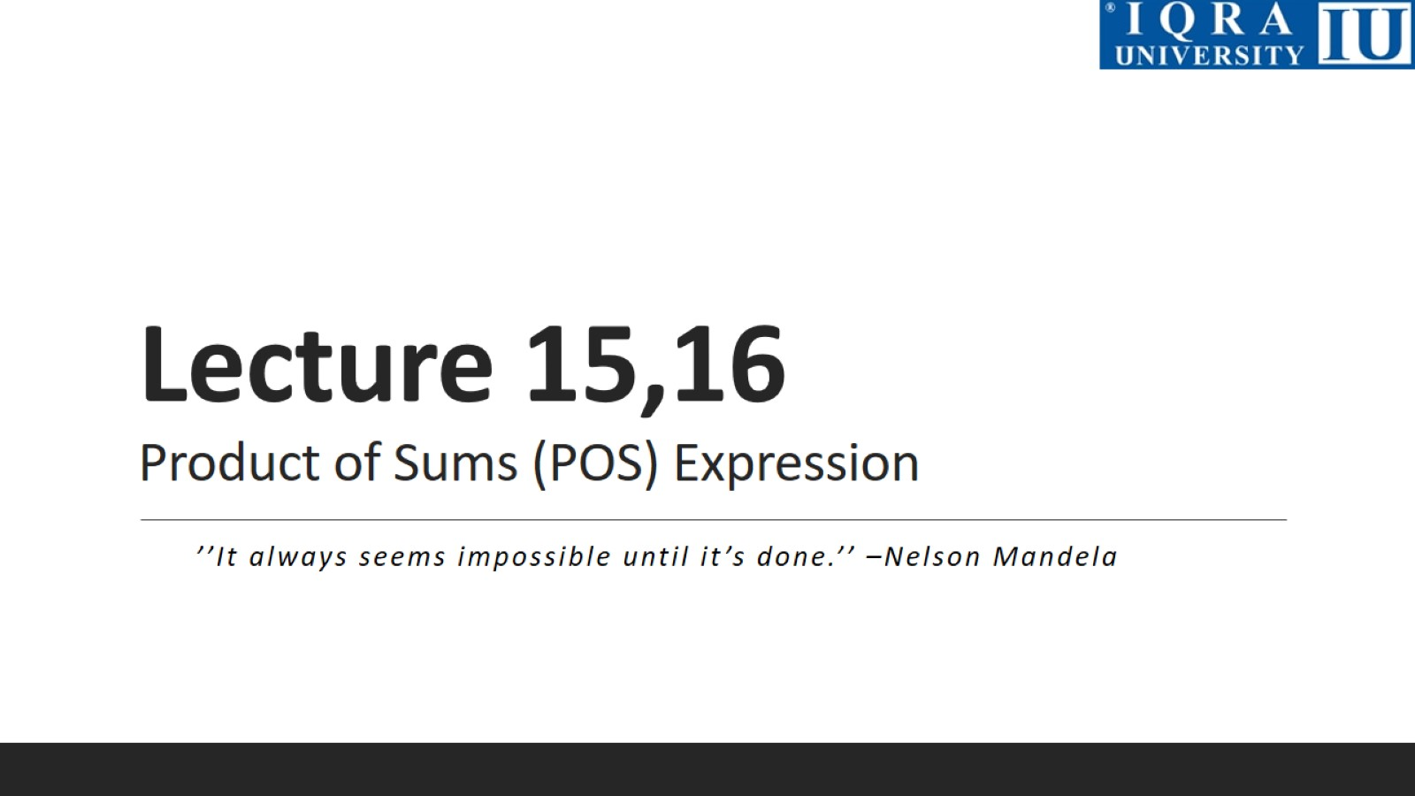
Lecture 15,16 Product of Sums (POS) Expression

Slide 3
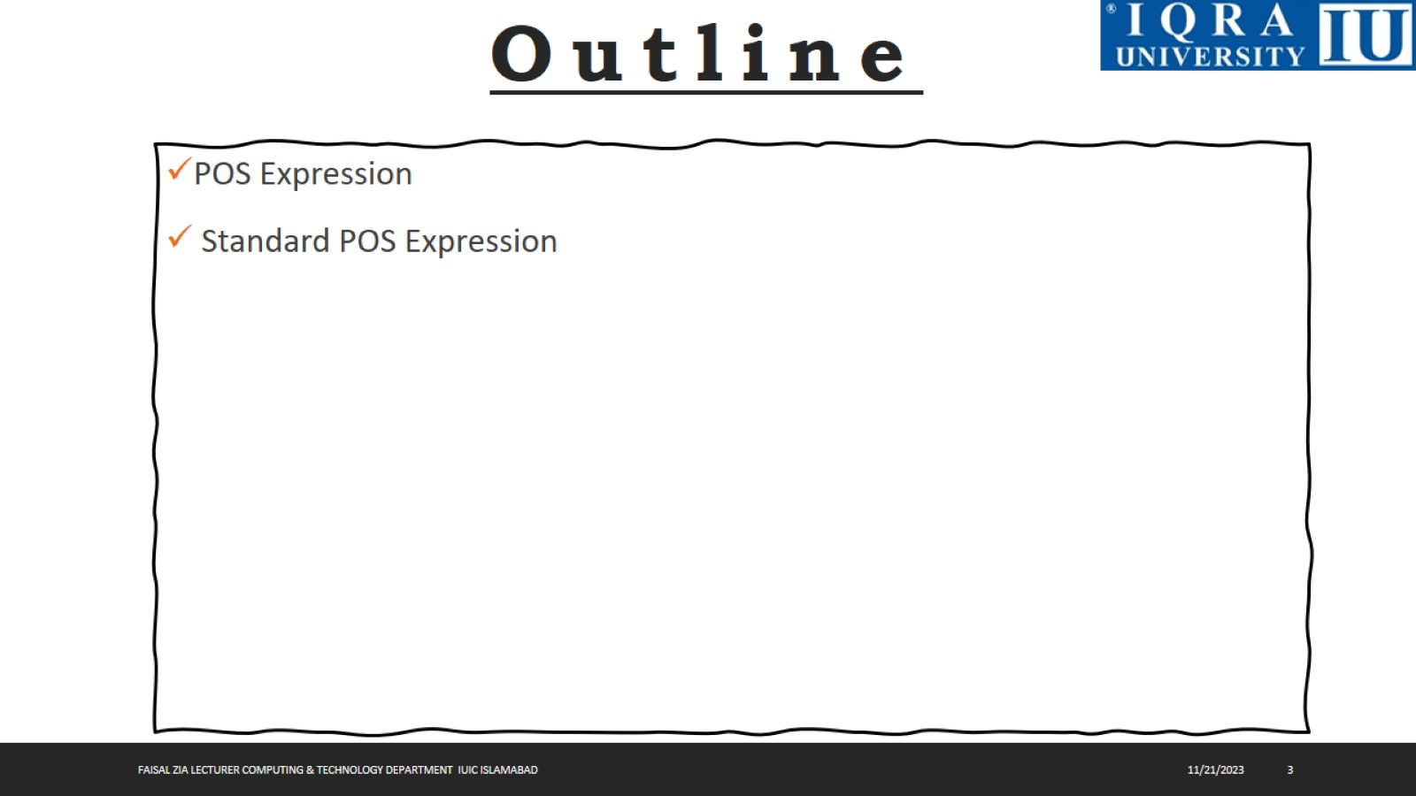

Slide 4
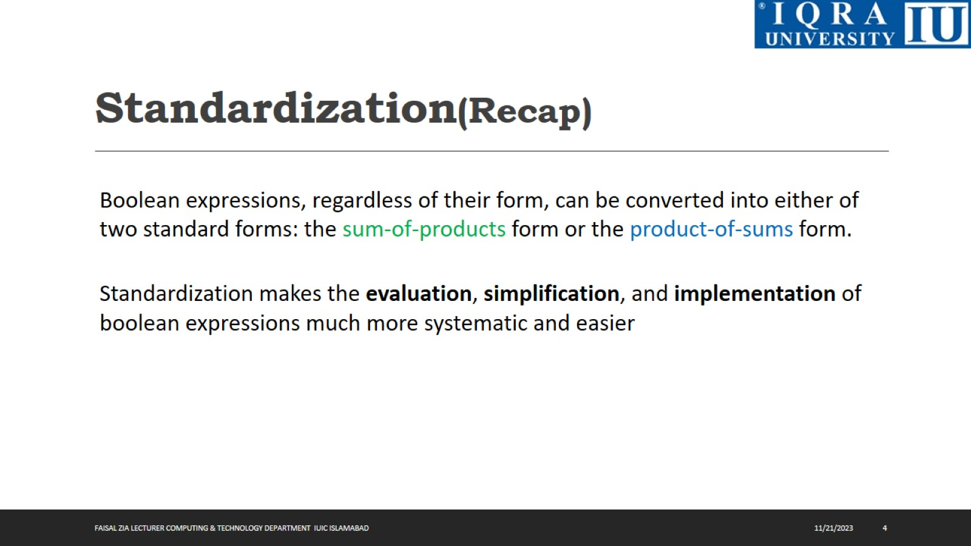
Standardization(Recap)

Slide 5
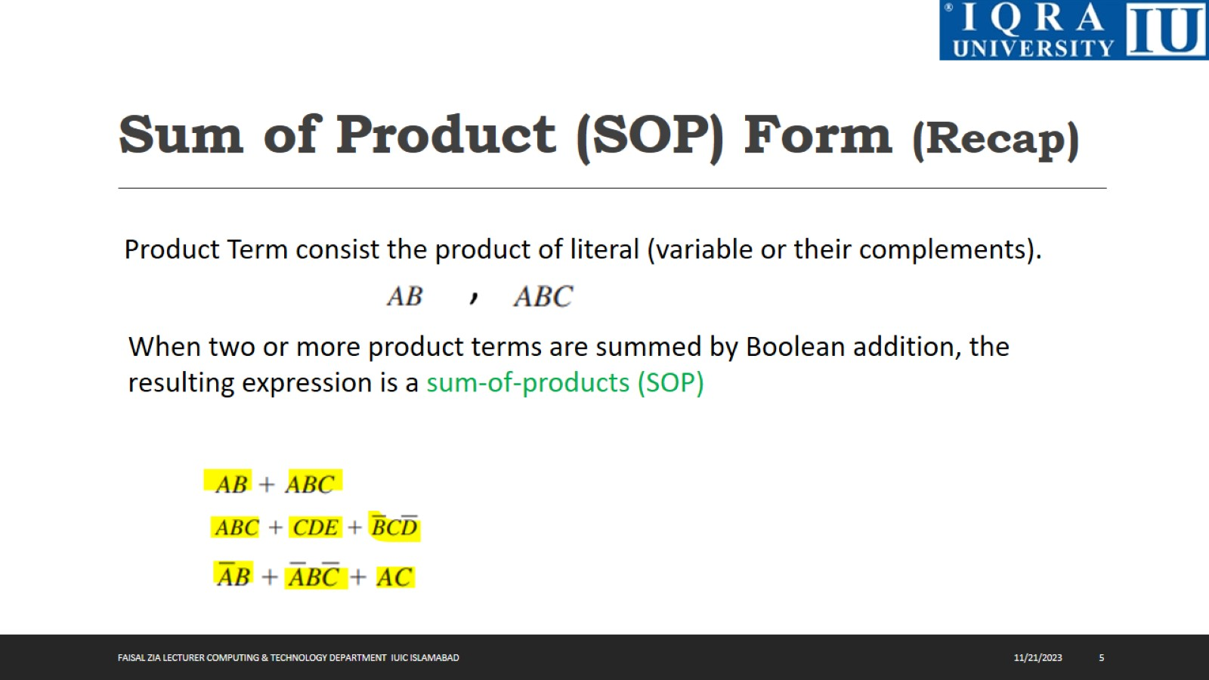
Sum of Product (SOP) Form (Recap)

Slide 6
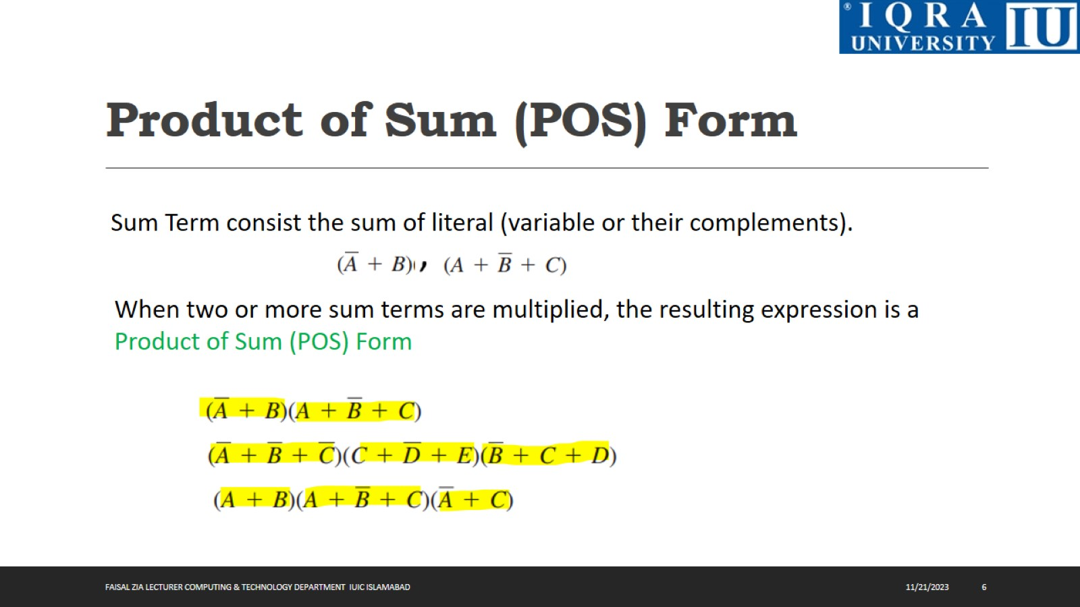
Product of Sum (POS) Form

Slide 7
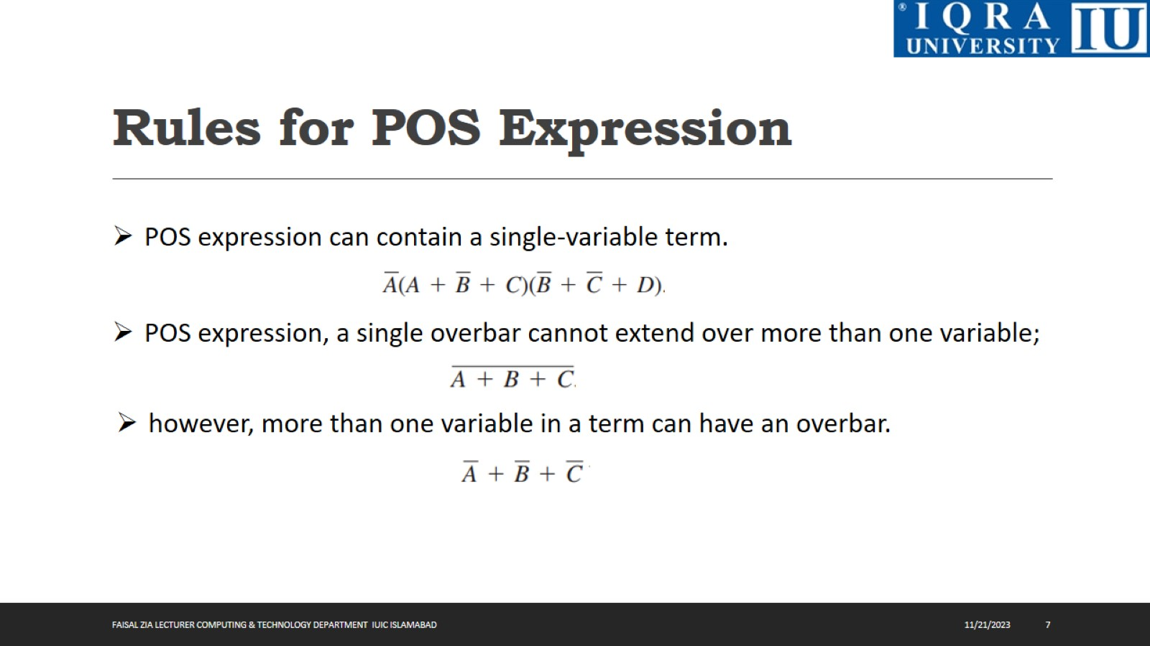
Rules for POS Expression

Slide 8
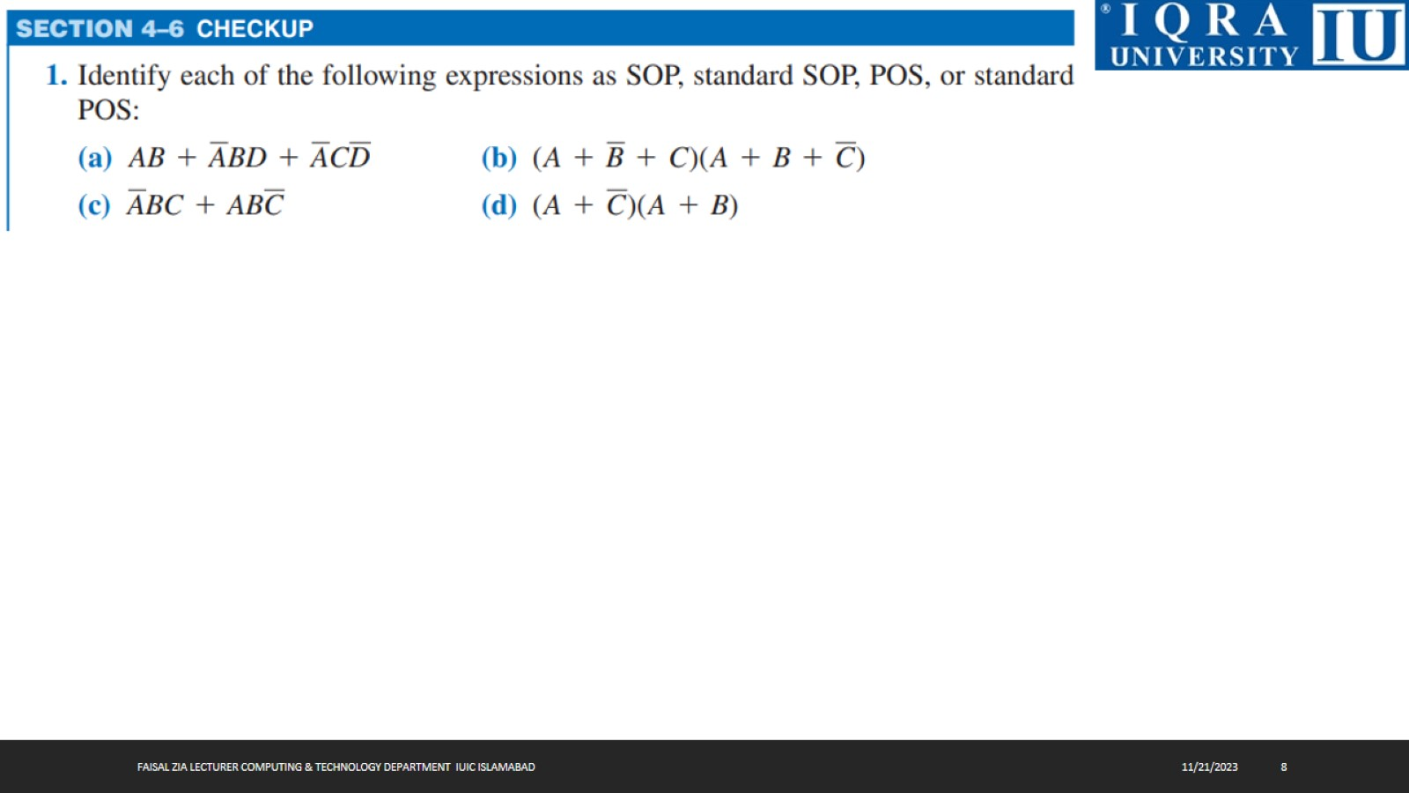

Slide 9
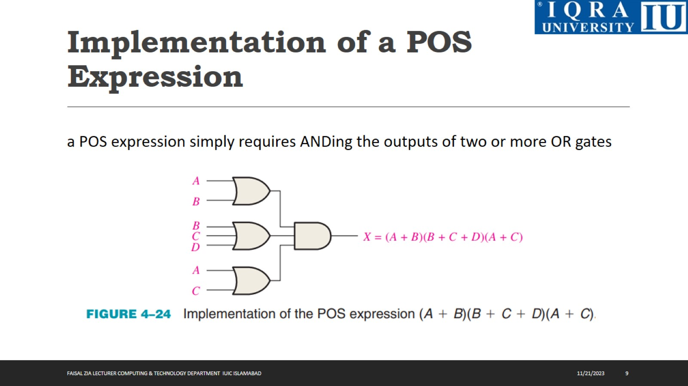
Implementation of a POS Expression

Slide 10
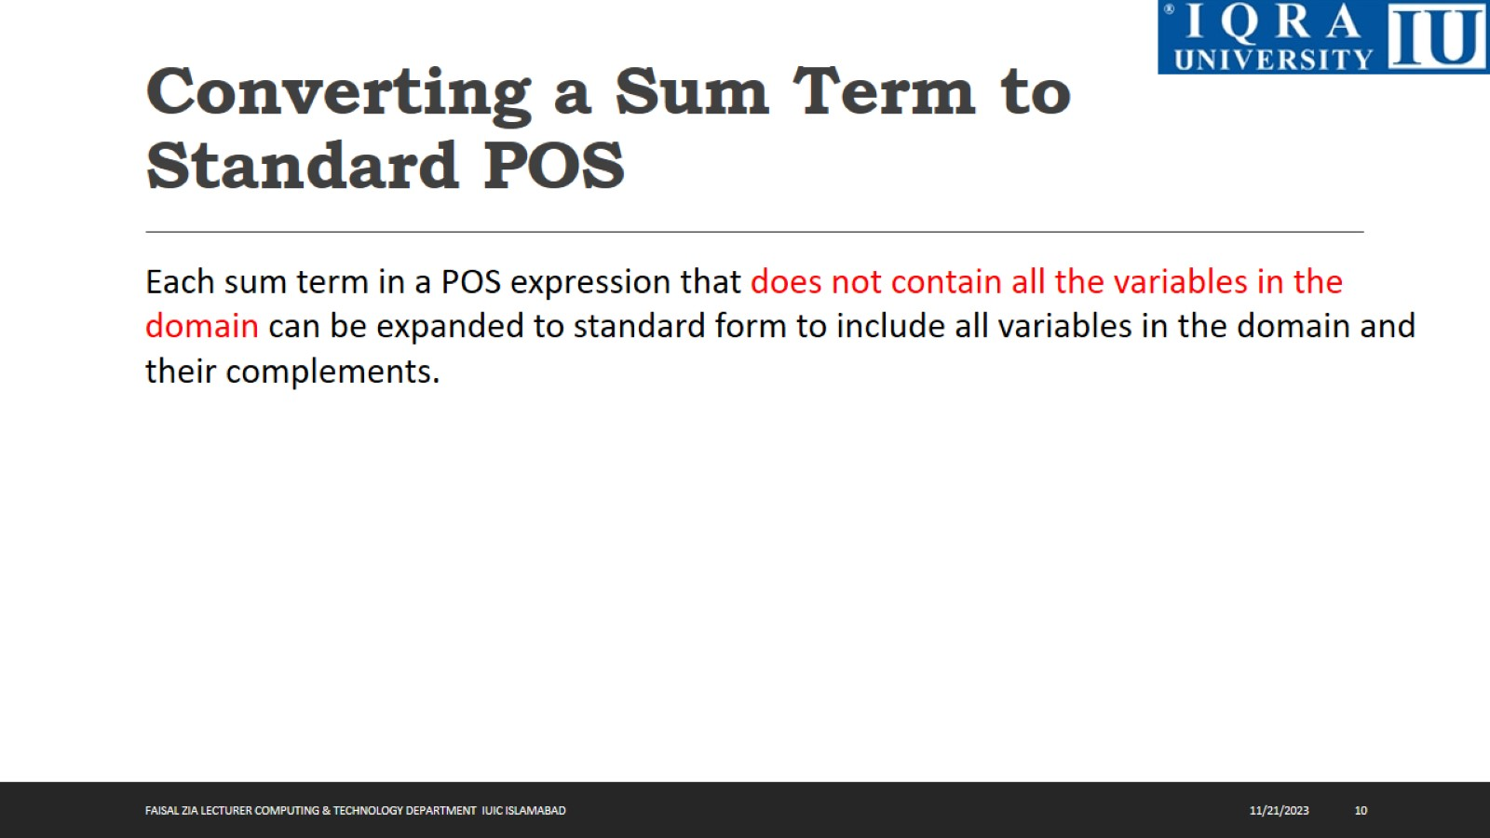
Converting a Sum Term to Standard POS

Slide 11
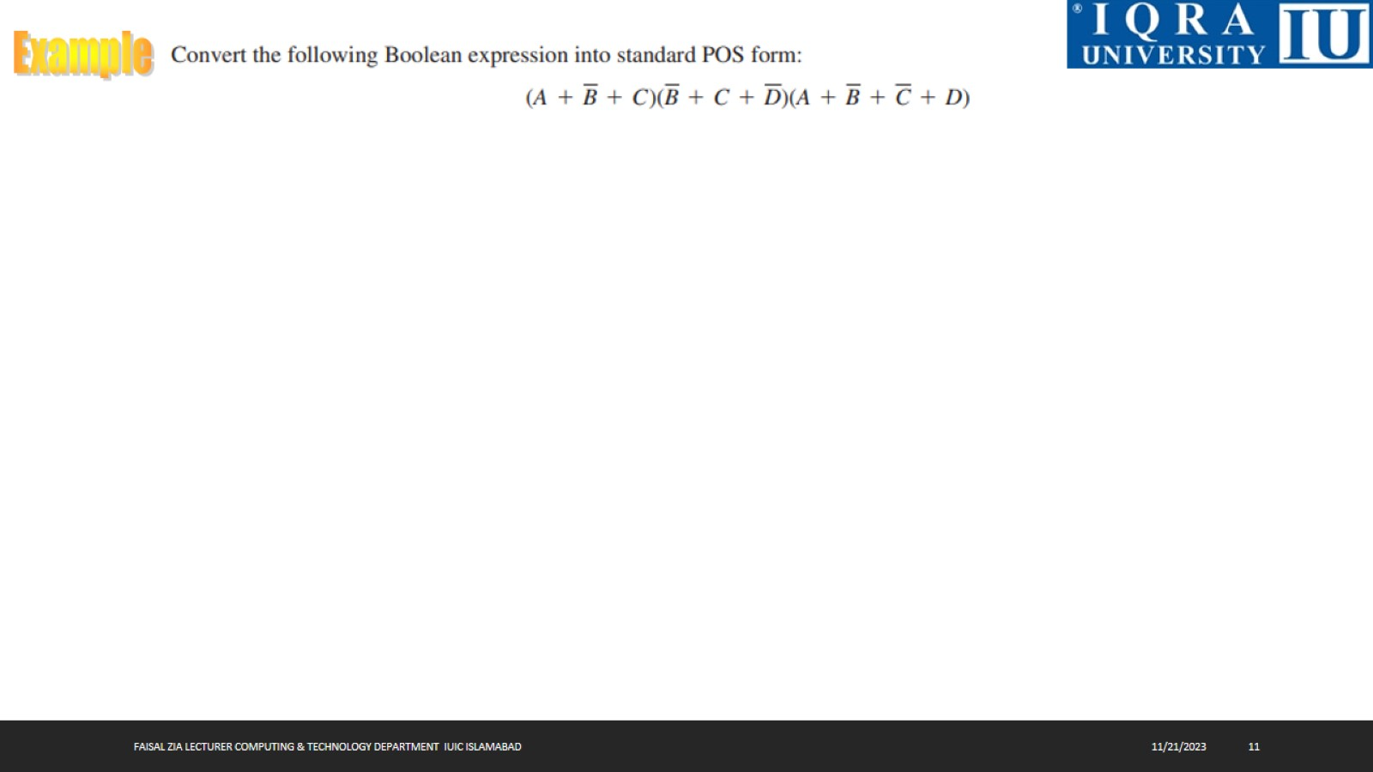

Slide 12


Slide 13
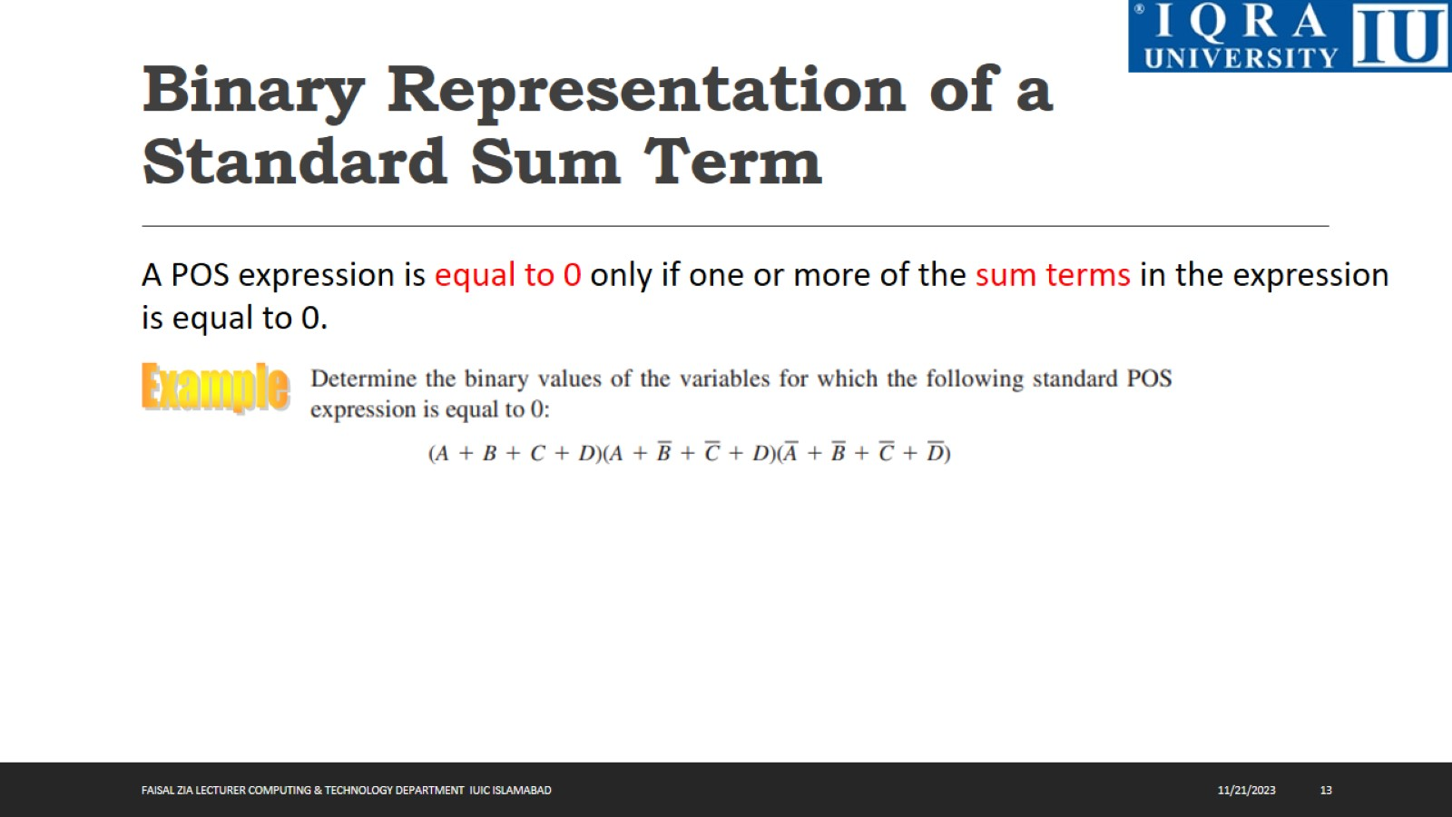
Binary Representation of a Standard Sum Term

Slide 14
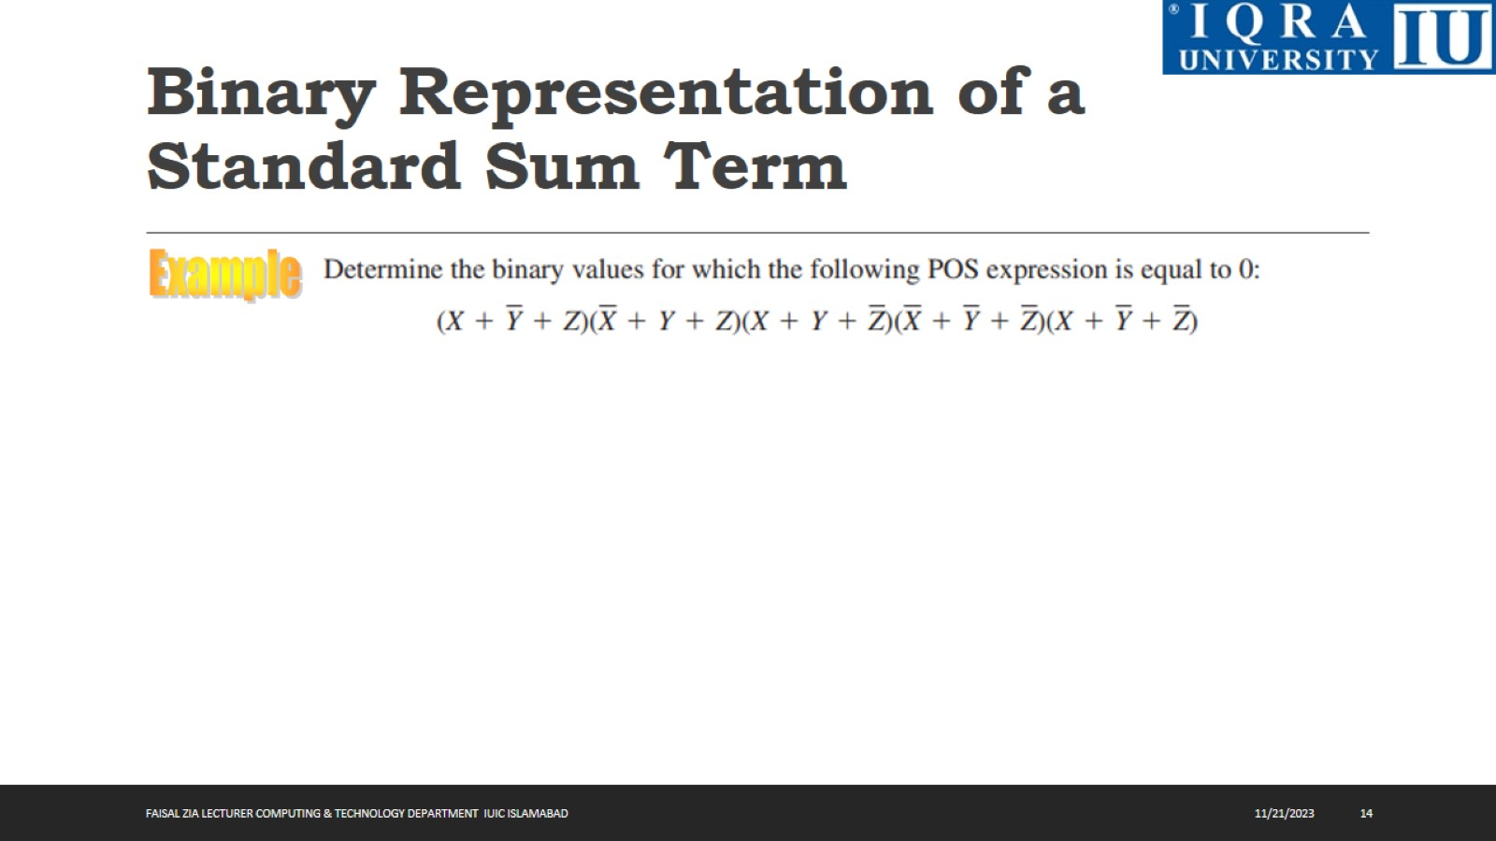
Binary Representation of a Standard Sum Term

Slide 15
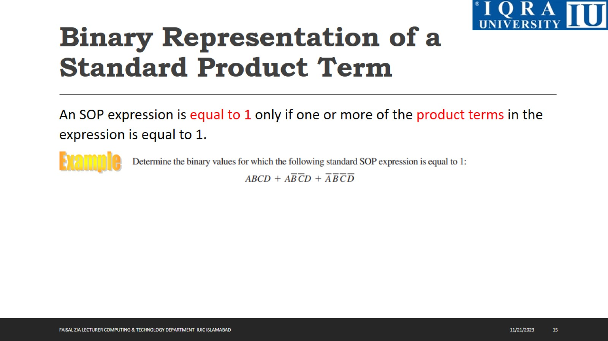
Binary Representation of a Standard Product Term

Slide 16
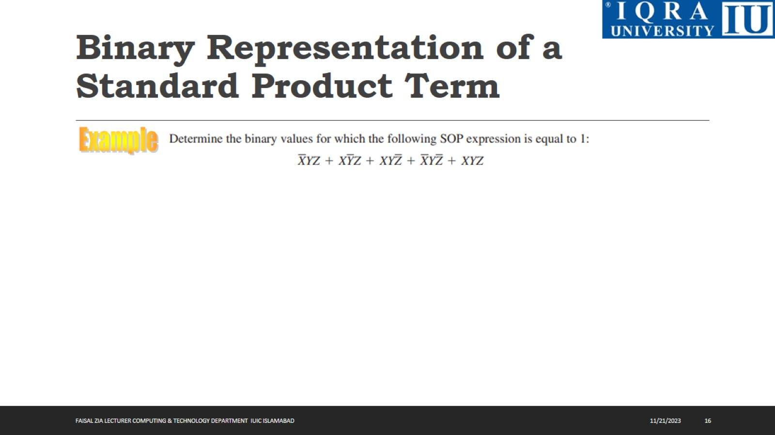
Binary Representation of a Standard Product Term

Slide 17
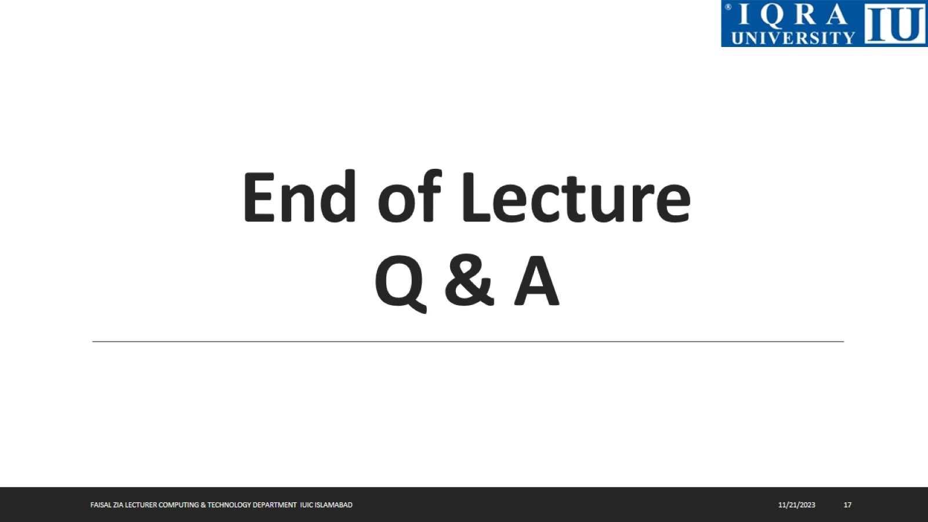
End of Lecture Q & A

